Slide 1
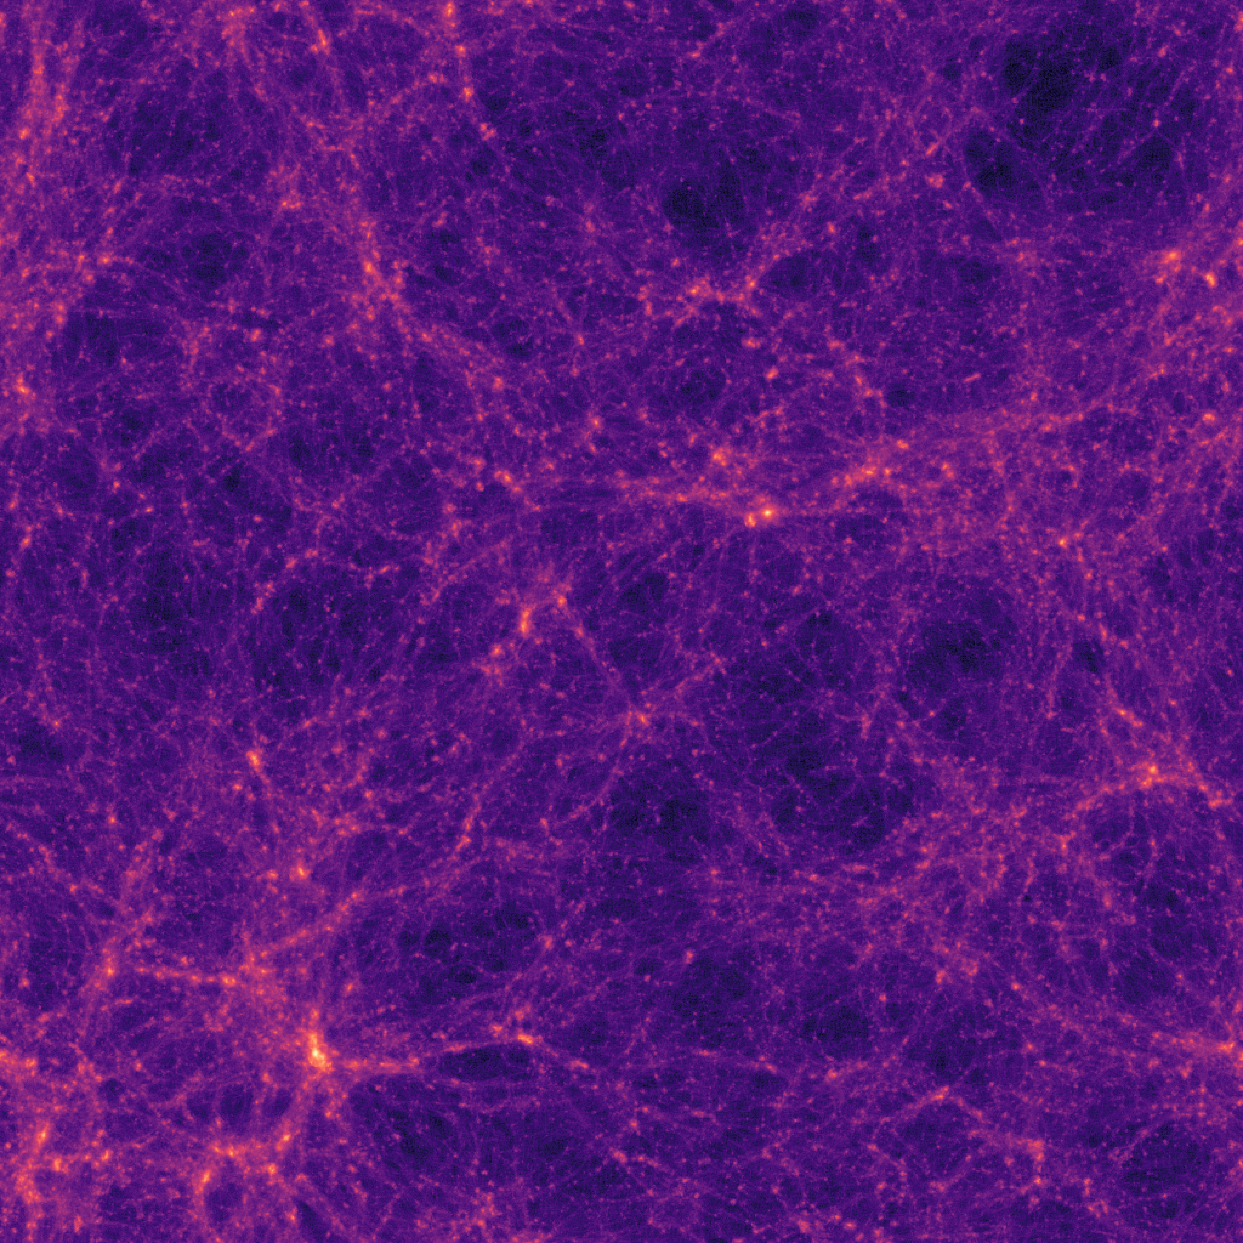


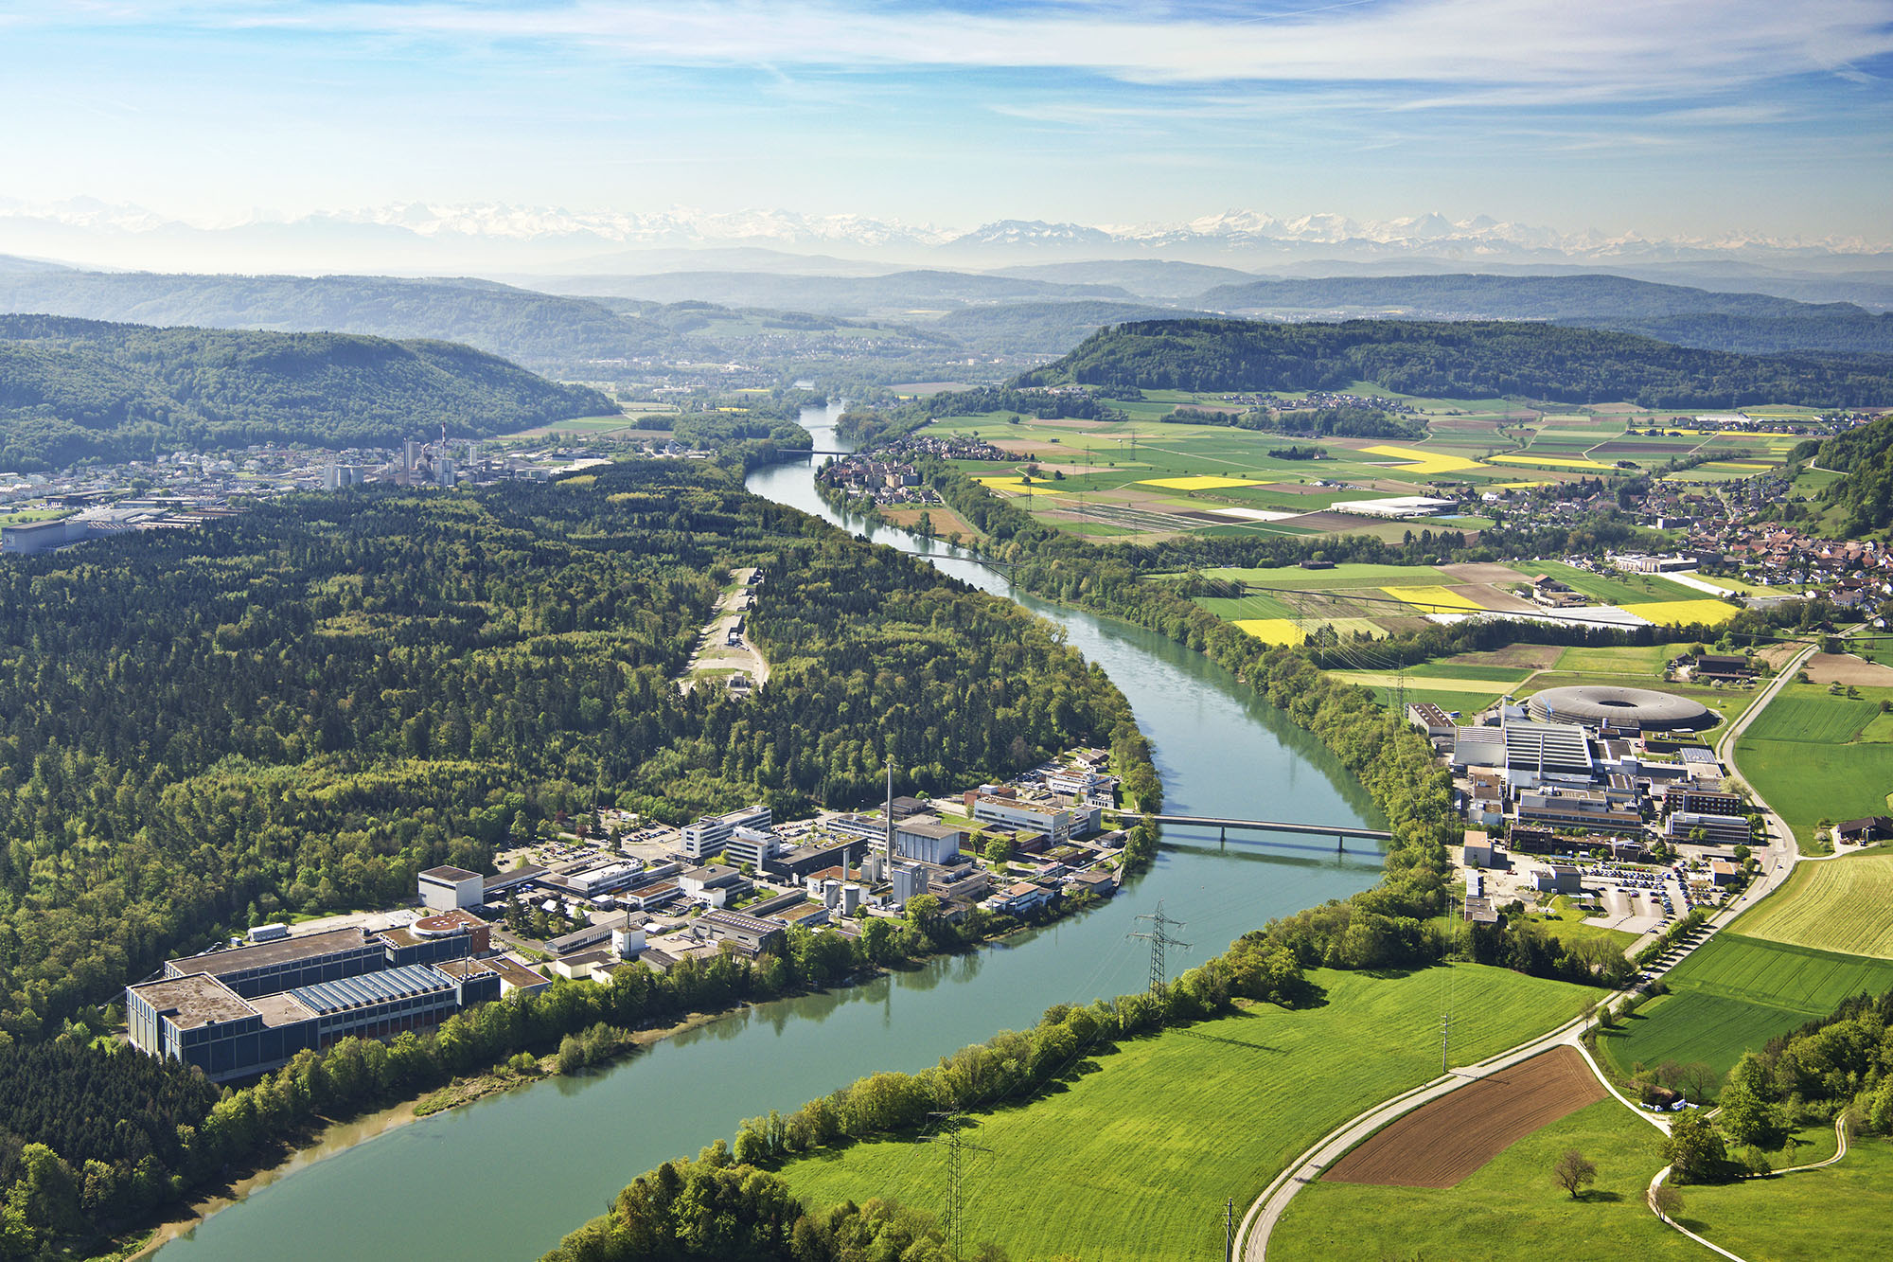
Final Presentation – Semester Thesis Cosmological Structure Formation with IPPL
Blanca Crazzolara
18th July 2024

Slide 2

Outline
Project Objective
Theoretical Background
Numerical Implementation
Scaling Study Results
Conclusion and Outlook

Slide 3
Thesis Objective
Implement a Mini App for Cosmological simulations using IPPL → addition to Alpine for plasma physics
Motivation: take advantage of similarities in the nature of the physical equations
Demonstrate versatility of IPPL

Slide 4
Outline
Project Objective
Theoretical Background
Numerical Implementation
Scaling Study Results
Conclusion and Outlook

Slide 5
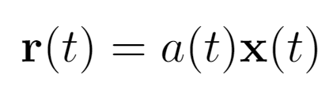
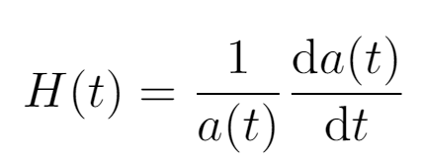
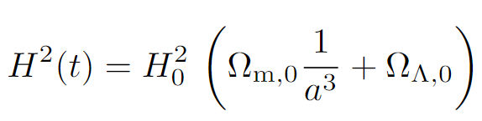
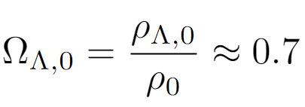
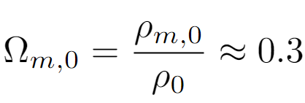

Background Expansion of the Universe ($Λ$CDM)
Physical vs. Comoving Coordinates:
Hubble parameter (expansion rate):
First Friedmann equation:

Slide 6
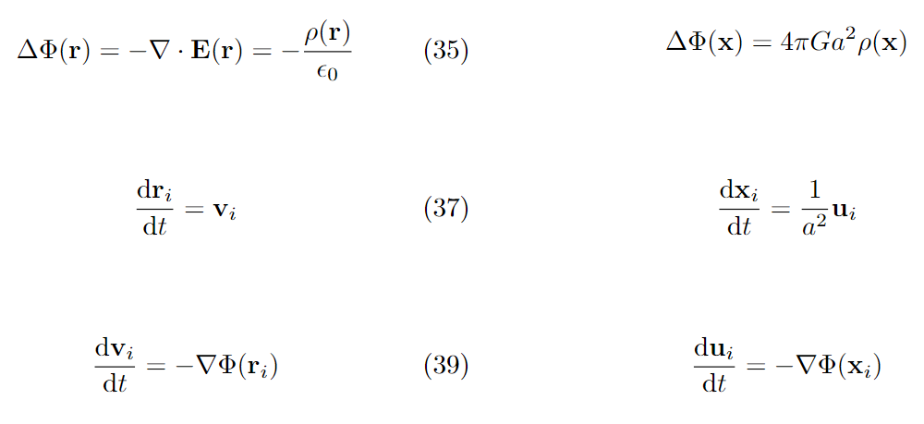

Background Physical Equations for $Λ$CDM
Electrostatic
Gravity
→

Slide 7
Background Structure Formation
Small perturbations in initially homogeneous density field grow over time. The overdensity is modelled as Gaussian random field.
Linear growing at early times
Later non-linear clustering due to gravitational collapse
→ Formation of Dark Matter haloes and Galaxies

Slide 8
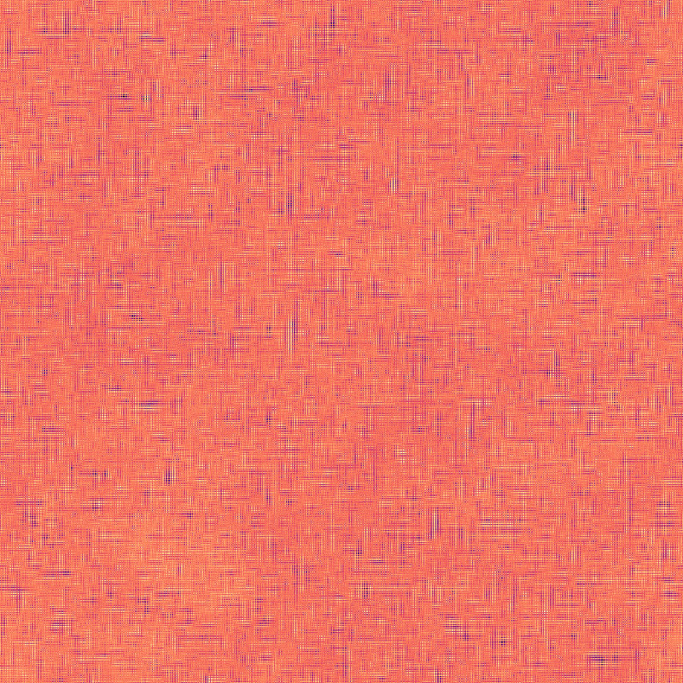
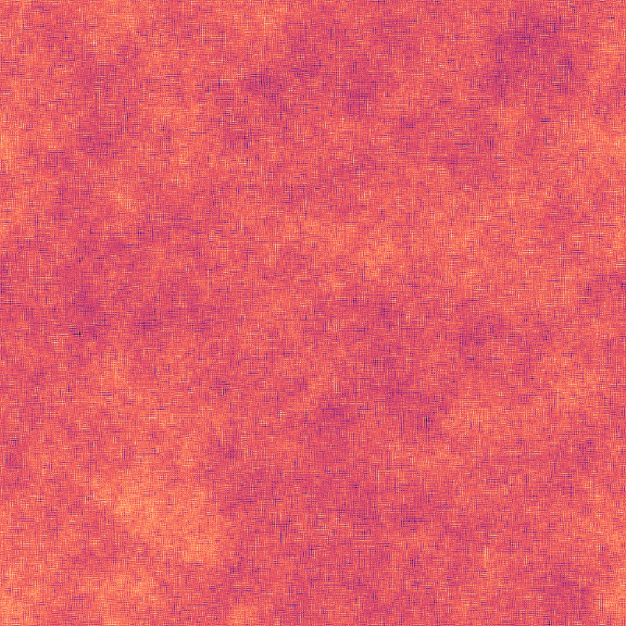
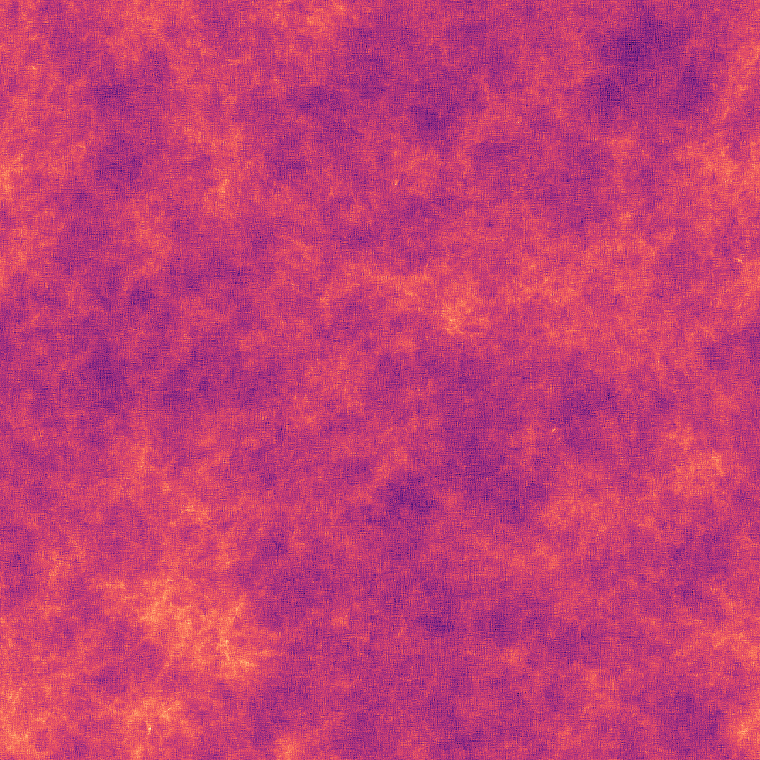
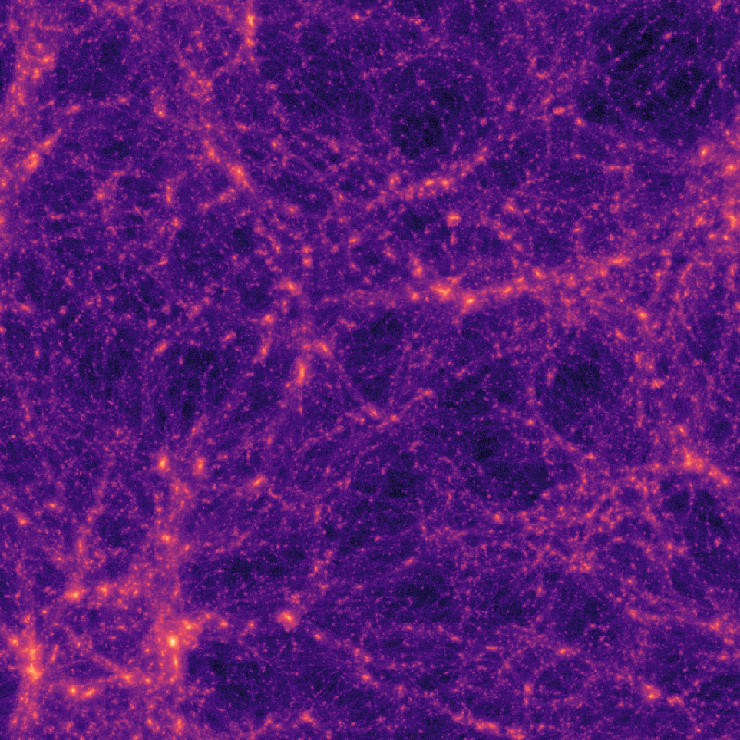
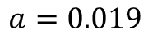
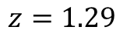
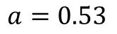
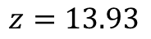
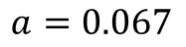
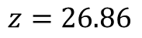
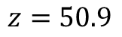
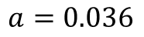
Background Structure Formation
Initial Perturbations
Linear Growing
Non-linear Clustering
Scale Factor:
$$a=0.019$$
$$a=0.036$$
$$a=0.067$$
$$a=0.53$$
Redshift:
$$z=50.9$$
$$z=26.86$$
$$z=13.93$$
$$z=1.29$$

Slide 9
Outline
Project Objective
Theoretical Background
Numerical Implementation
Scaling Study Results
Conclusion and Outlook

Slide 10
Methods Initial Conditions
Perturbations from a homogeneous density field.
Generation with N-GenIC code (developed by the Max-Planck-Institute)
→ particle positions and velocities
Saved as one CSV file and read into Mini App. Assignment of particles to corresponding processor domain.

Slide 11
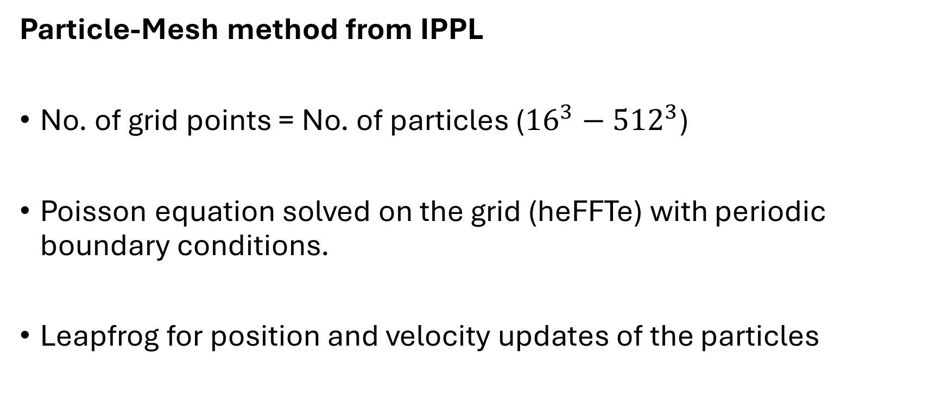
Methods Time Evolution
Particle-Mesh method from IPPL
No. of grid points = No. of particles (${16}^{3}−{512}^{3}$)
Poisson equation solved on the grid (heFFTe) with periodic boundary conditions.
Leapfrog for position and velocity updates of the particles

Slide 12
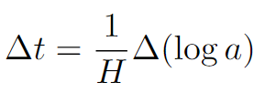
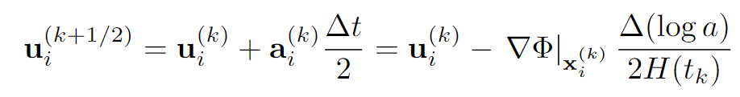
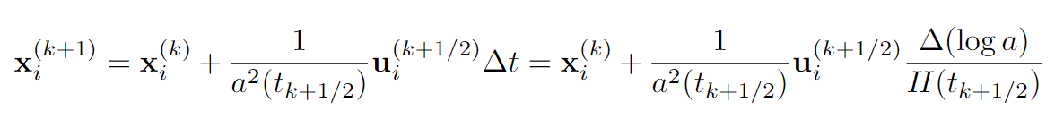
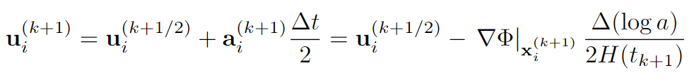
Methods Leapfrog
Timestep
with fixed (smaller steps during fast expansion)
Kick-Drift-Kick Scheme

Slide 13
Outline
Project Objective
Theoretical Background
Numerical Implementation
Scaling Study Results
Conclusion and Outlook

Slide 14
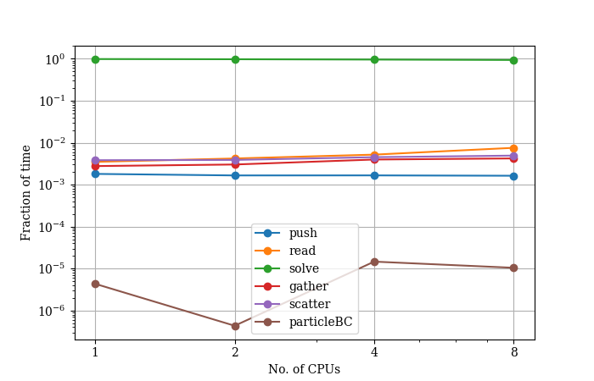
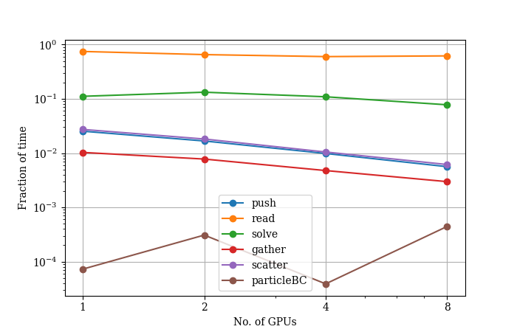
Results Timing Contributions
CPUs on Merlin
GPUs on Gwendolen
Example Problem size: ${512}^{3}$ particles, $500$ timesteps

Slide 15
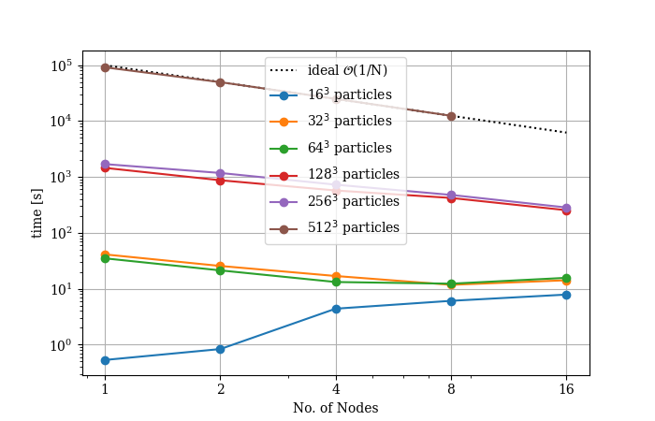
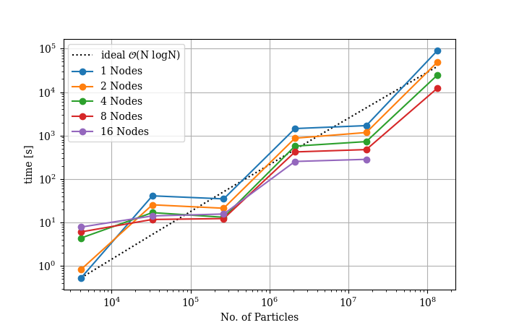
Results CPU Solver Scaling (1 CPU per node)
→ Good scaling performance for large problem sizes ($\sim {128}^{3}$)

Slide 16
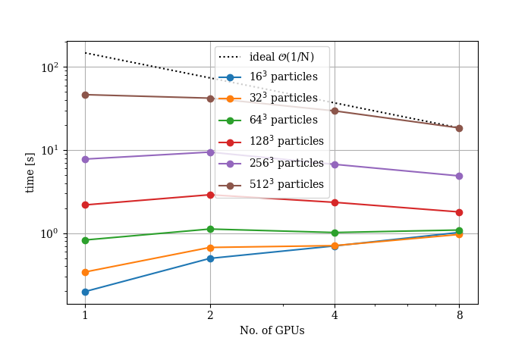
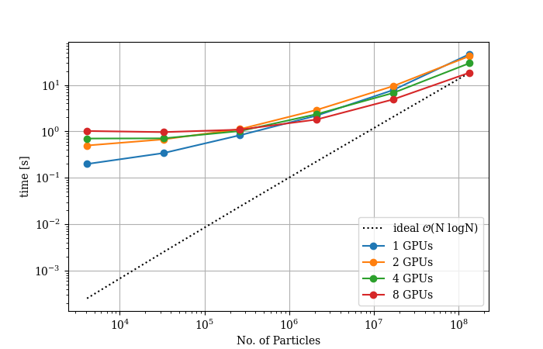
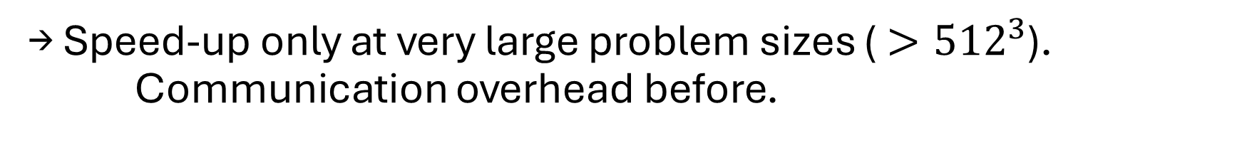
Results GPU Solver Scaling (on 1 node)
→ Speed-up only at very large problem sizes (${>512}^{3}$). Communication overhead before.

Slide 17
Conclusion
Code successfully tested on CPUs on Merlin and Euler and GPUs on Gwendolen.
Solver scales well on CPUs, on GPUs only for very large problem sizes.
Read-In is extremely inefficient on GPUs. Improvement required.

Slide 18
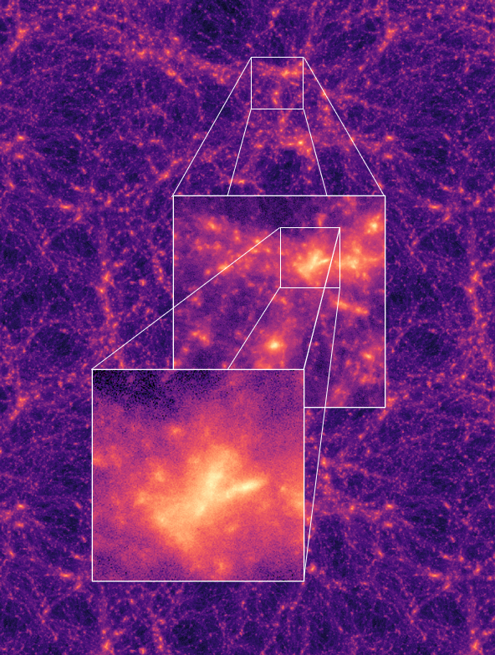
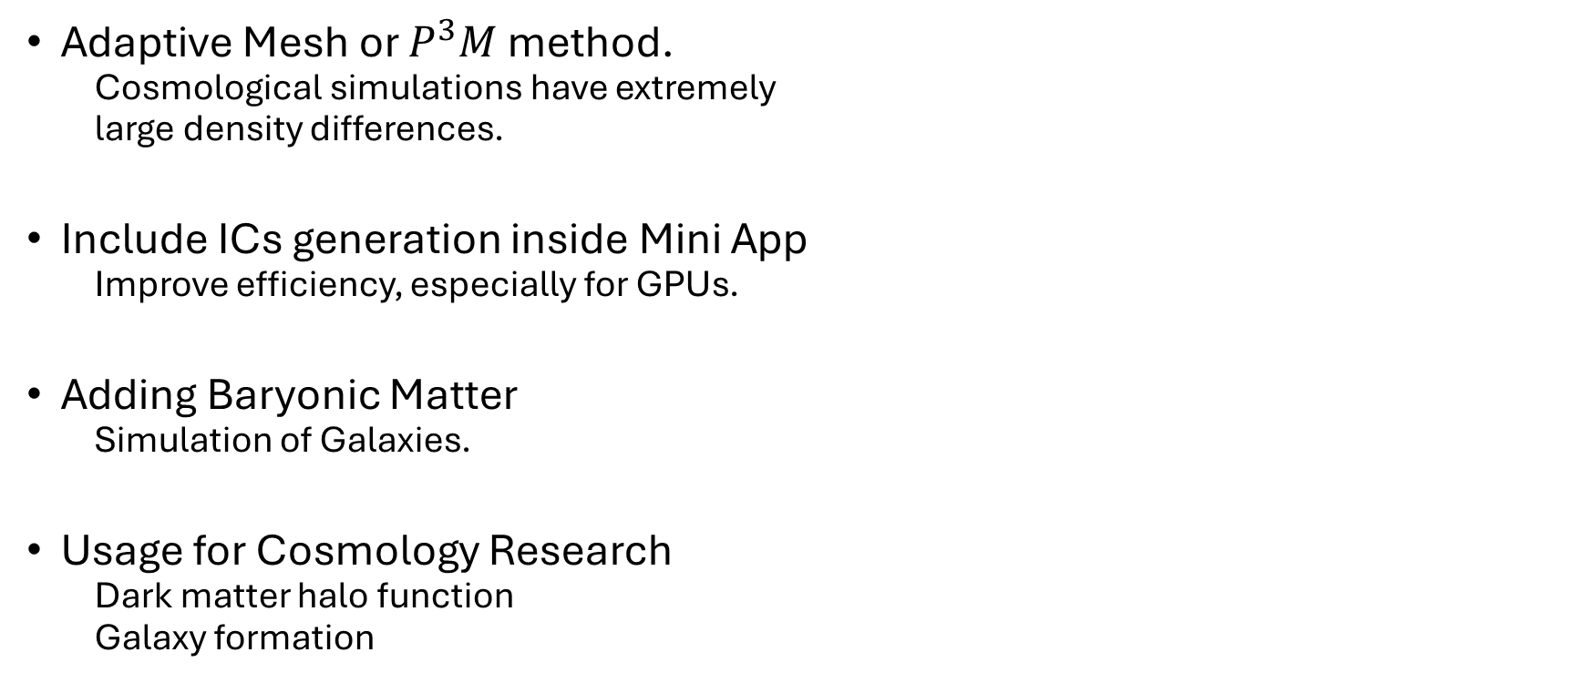
Outlook
Adaptive Mesh or $P^{3}M$ method.
Cosmological simulations have extremely
large density differences.
Include ICs generation inside Mini App
Improve efficiency, especially for GPUs.
Adding Baryonic Matter
Simulation of Galaxies.
Usage for Cosmology Research
Dark matter halo function
Galaxy formation

Slide 19
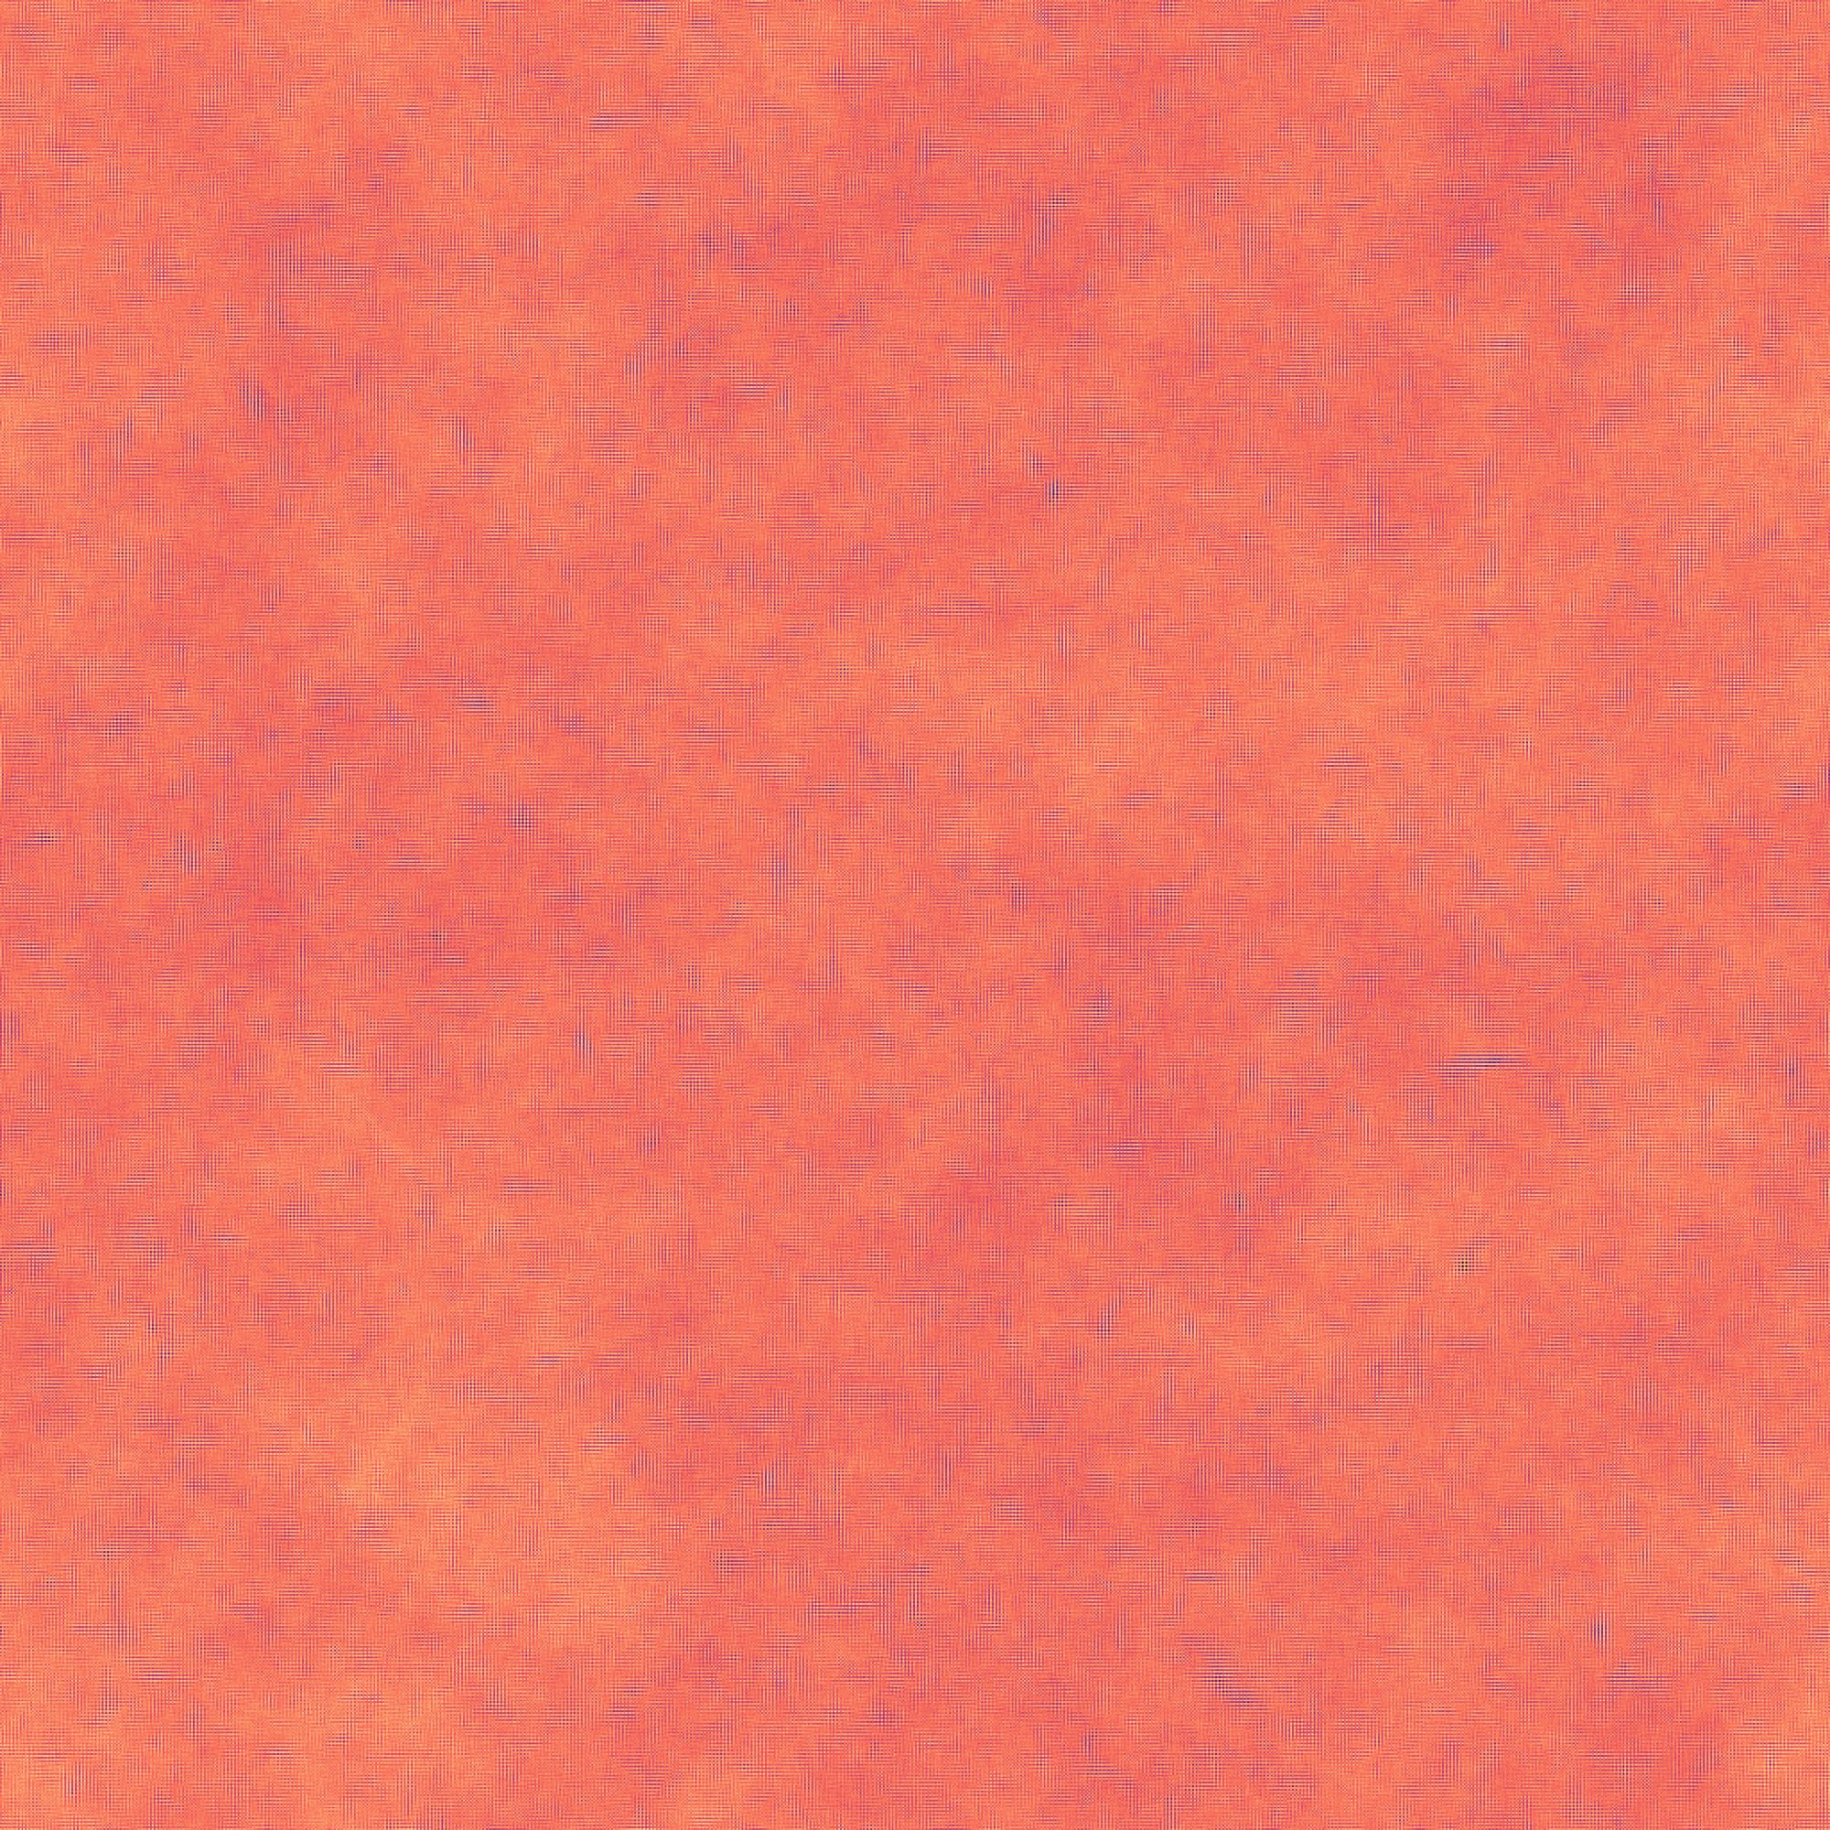
Thank you for listening. Questions?
Thank you for listening.
Questions?

Slide 20
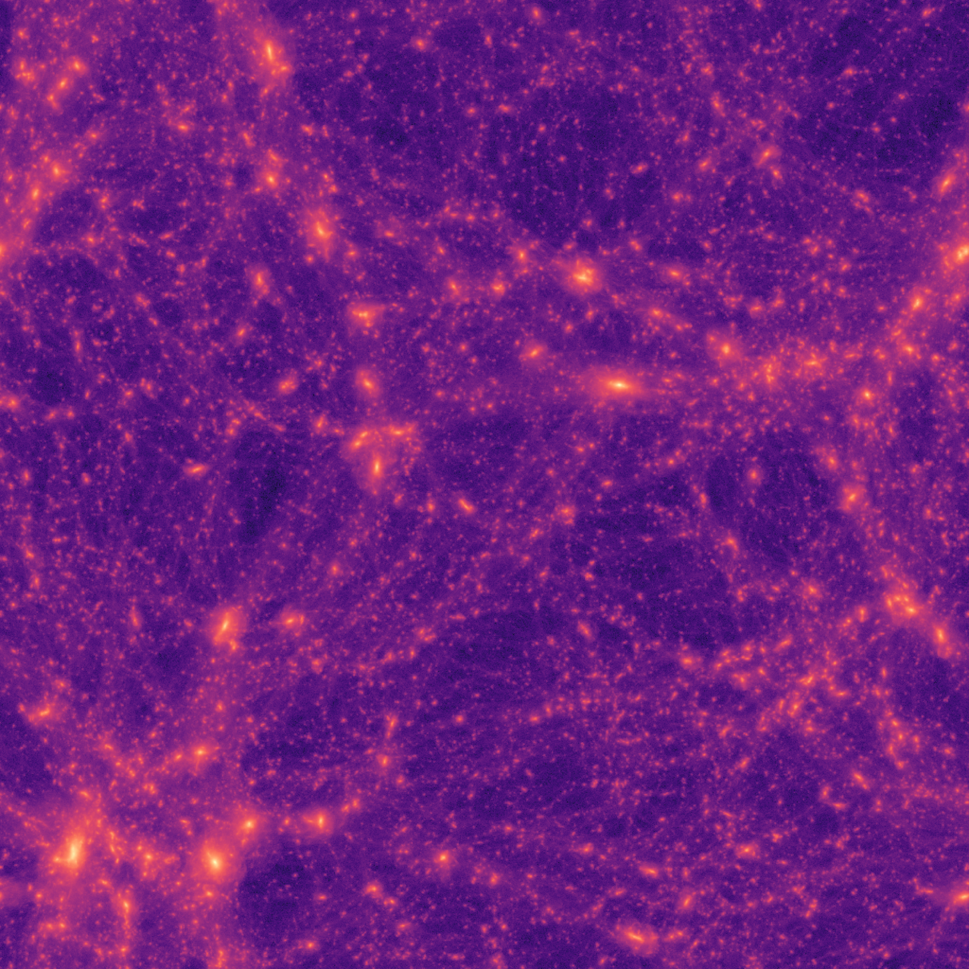
Thank you for listening. Questions?
Thank you for listening.
Questions?

